Slide 1
MT104-Linear Algebra

Slide 2

What is Linear Algebra ?
Definition: Linear algebra is the branch of mathematics concerning vector space and linear mapping
between such spaces.
OR
Linear algebra is the study of linear systems of equations.

Slide 3
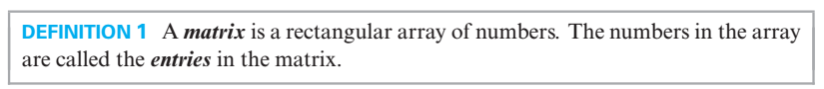

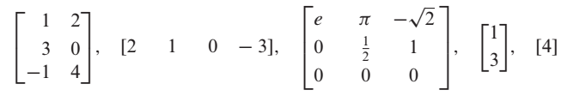
A

Slide 4
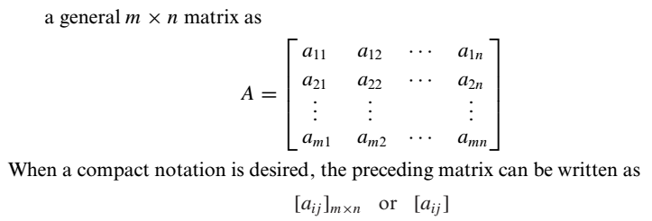
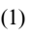
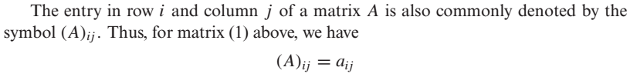
A
is

Slide 5
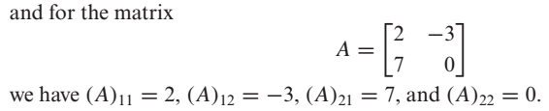

Slide 6
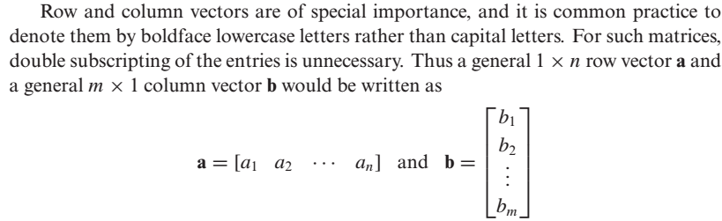
Row Vector and Column Vector

Slide 7
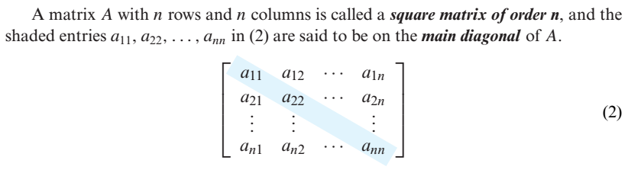
Square Matrix and Main Diagonal

Slide 8

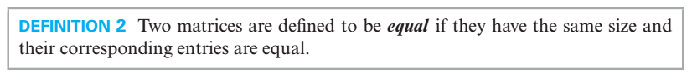
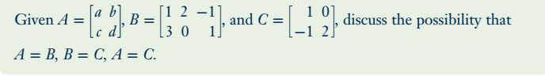
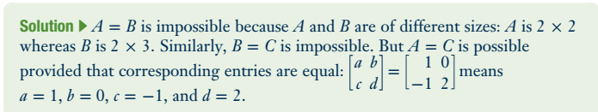
Problem

Slide 9
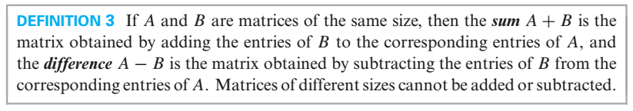
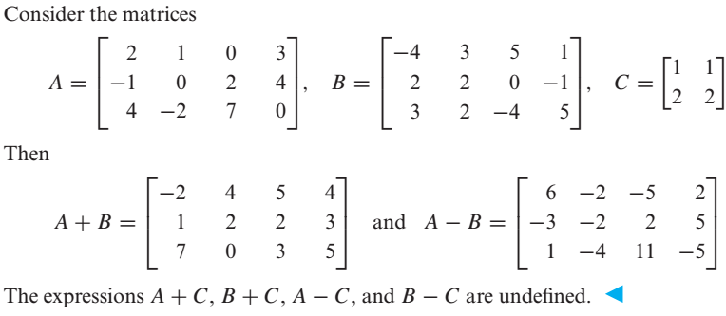

Slide 10
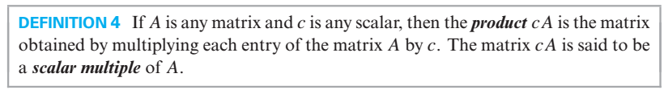
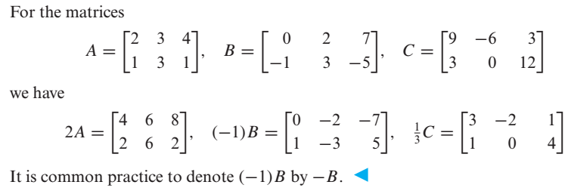
Scalar Multiples of a Matrix

Slide 11
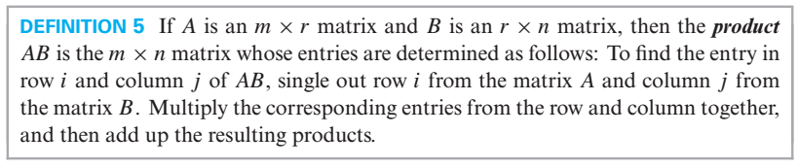
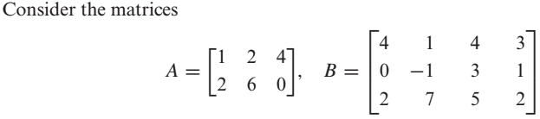
Product of Two Matrices

Slide 12
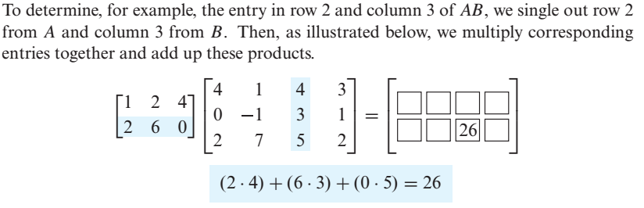
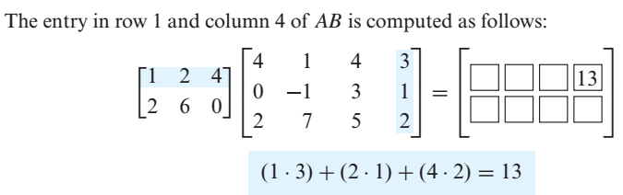

Slide 13
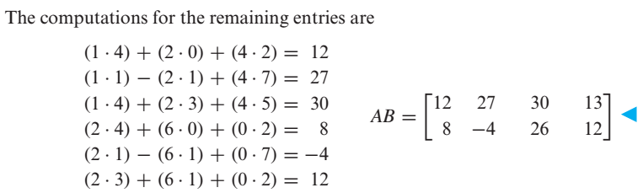

Slide 14
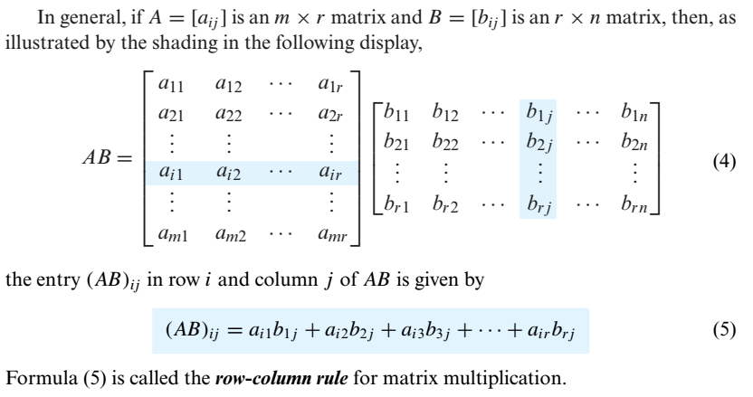

Slide 15

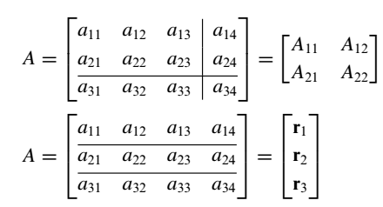
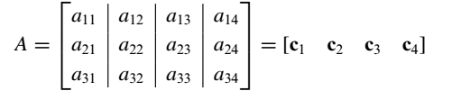
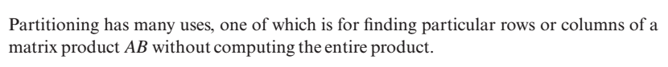
e.g

Slide 16

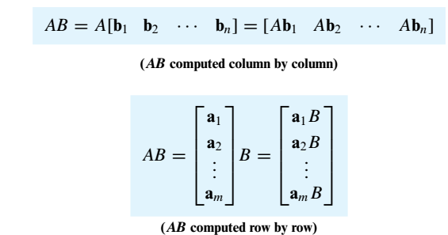

Slide 17
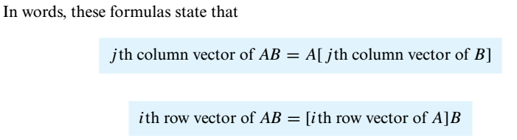
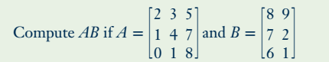
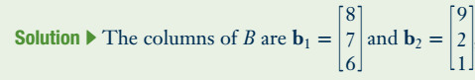
Problem

Slide 18
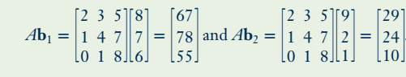
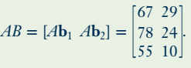

Slide 19
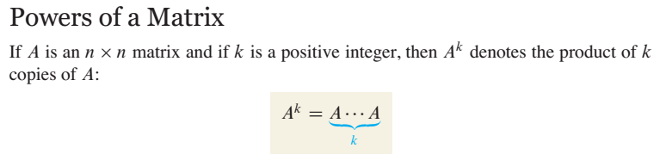
For instance , in order to find $A^{2}$ we will multiply $A$ with $A$.

Slide 20
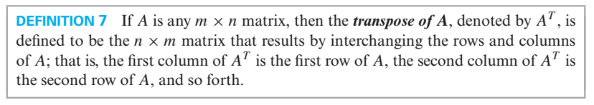
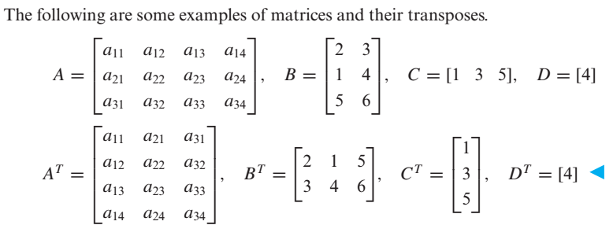
Transpose of a Matrix

Slide 21
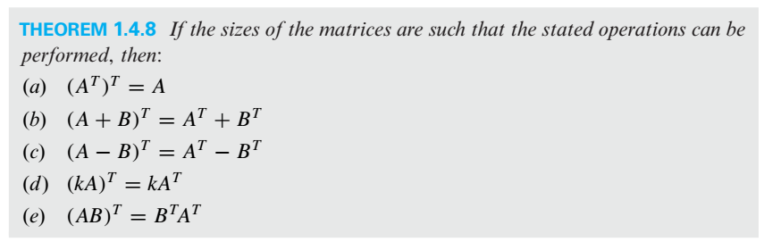
Properties of Transpose

Slide 22
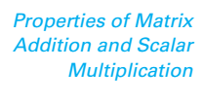
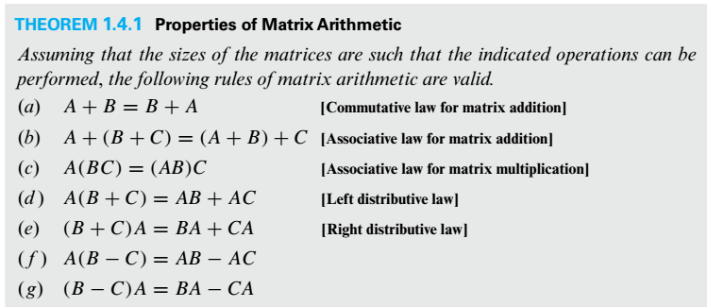

Slide 23
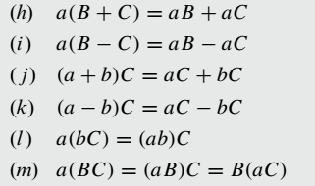

Slide 24
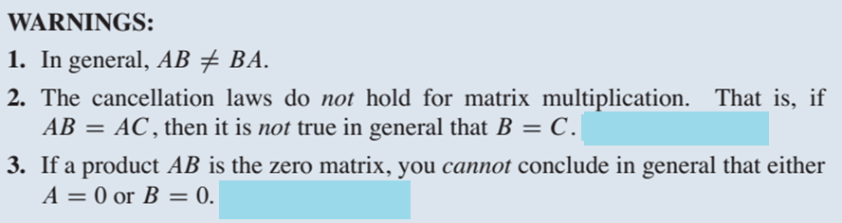
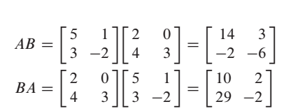
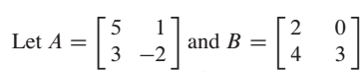
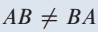
Example on Point 1

Slide 25
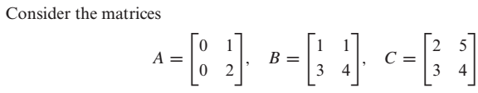
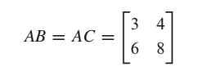
Example on Point 2
Here
But

Slide 26
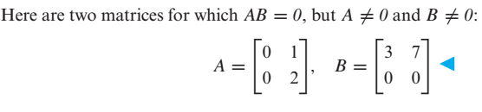
Example on Point 3

Slide 27

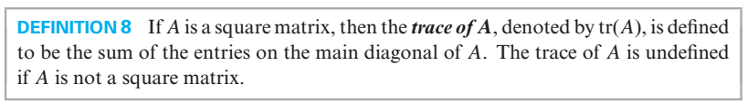
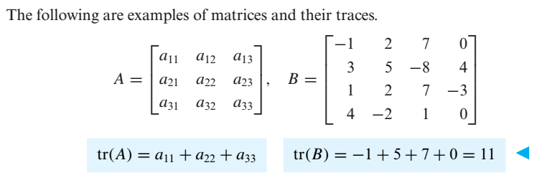

Slide 28
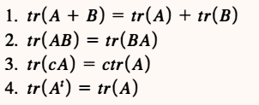

Slide 29

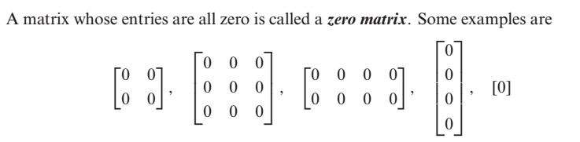

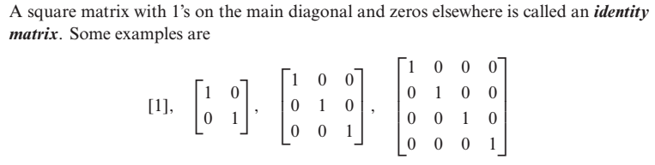

Slide 30

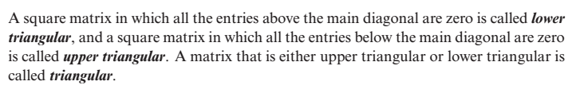


Slide 31




Slide 32


Slide 33





Equivalent Matrices
e.g $I_{2}$and the matrix
are equivalent because we can obtain A from identity matrix by multiplying row 2 by -3
Elementary Matrix

Slide 34


Slide 35


Determinants
For 2×2 Matrices the formula is
Let’s talk about minor and cofactor of an element with the help of which we will calculate determinants of higher order matrices.

Slide 36




Minor & Cofactor of an element (In a Square Matrix)

Slide 37


Slide 38



Slide 39



Problem
By cofactor expansion along the first Row

Slide 40


By cofactor expansion along the first coulmn

Slide 41



Slide 42

e. g

Slide 43



Slide 44



Slide 45



Slide 46




Slide 47




Slide 48



Slide 49



Slide 50




Slide 51



Slide 52



In general

Slide 53

Evaluating Determinants by Row Reduction

Slide 54




Slide 55




Slide 56



Slide 57



Slide 58





Slide 59



Slide 60


Slide 61





Inverse of a 2 $×$ 2 Matrix

Slide 62


Slide 63





Problem
Find the inverse of the matrix
Sol
Another method for finding inverse of a matrix is illustrated in the coming slides.

Slide 64



Slide 65


Slide 66



Slide 67


Slide 68


Note

Slide 69



Slide 70





Slide 71


Slide 72





Slide 73

General Form of a Diagonal Matrix

Slide 74


Inverse of a Diagonal Matrix
Power of a Diagonal Matrix

Slide 75


Slide 76


A matrix is said to be in Echelon form if it has the following properties
Every nonzero row precedes every zero row.
In each successive nonzero row, the number of zeros before the leading entry of a row
increases row by row.

Slide 77





Slide 78


Rank of a Matrix
The number of nonzero rows in the echelon form of a matrix is called rank of the matrix.

Slide 79






Linear System
is a solution of

Slide 80


In matrix form, we can write ( ) as
where,
A is called the

Slide 81


Slide 82




Slide 83


Slide 84

Important Points about Linear Systems
There are a lot of methods for solving linear systems, some methods work in special cases while some works for every type of linear system.
If in a linear system the number of equations is equal to the number of unknowns ( i.e. if the coefficient matrix is a square matrix i.e. if m = n ) then from determinant we can comment about the number of solution(s).
Any linear system in which $m=n$, and $\left|A\right|≠0$, has a unique solution. We can obtain this
unique solution by any of the following methods:
(i) Matrix Inversion Method (ii) Cramer's Rule
(iii) Gauss Elimination (iv) Gauss-Jordan Elimination
Furthermore, if the system is homogeneous then this unique solution is the trivial solution
(zero solution).

Slide 85

A homogeneous system has always a zero solution called trivial solution. Thus a homogeneous system is always consistent.
A homogeneous linear system in which $m=n$, and $\left|A\right|=0$, has infinite solutions ( i.e.
nontrivial solutions also exist).
5. In case of nonhomogeneous linear system in which $m=n$ and $\left|A\right|=0$, there is possibility
that the system has
(i) No Solution (ii) Infinite Solutions
6. If in a linear system the number of equations is not equal to the number of unknowns ( i.e. if
the coefficient matrix is not a square matrix i.e. if m $≠$n ) then we can comment about the
number of solution(s) by looking into the rank of coefficient matrix, rank of augmented
matrix and number of unknowns in the system. In this case we can find the solution(s) (if
exist) by either Gauss Elimination or by Gauss-Jordan Elimination.

Slide 86


Slide 87

(Because for homogeneous linear system Rank of the coefficient matrix is always equal to Rank of the augmented Matrix and if number of equations is less than unknowns this mean that common rank < n, so by third part of fundamental theorem, system will have infinite solutions.

Slide 88


Methods for solving a linear System
(or Gauss Elimination)

Slide 89


Problem

Slide 90





Slide 91





Slide 92





Slide 93



Slide 94




Slide 95




Slide 96



Slide 97


Slide 98


Slide 99


Problem

Slide 100


If we reduced the augmented matrix to reduce echelon form we have

Slide 101


Slide 102


Slide 103


Problem

Slide 104



e.g.

Slide 105





Slide 107



Slide 108




Slide 109


Slide 110


Slide 111


Slide 112



Slide 113


Slide 114



Slide 115






Slide 116




Slide 117



Slide 118


Slide 119




Slide 120


Linear Combination

Slide 121



Slide 122


Slide 123

Spanning Set

Slide 124



Slide 125


Two Major Problems to Address
Problem

Slide 126




Slide 127


Problem

Slide 128


Slide 129




Slide 130


Slide 131


Problem

Slide 132



Slide 133



Slide 134



Slide 135

Wronskian

Slide 136



Slide 137




Slide 138



Slide 139


Dimension

Slide 140



Slide 141


Slide 142



Slide 143



Slide 144



Slide 145


Problem

Slide 146


Slide 147


Problem

Slide 148



Slide 149





Slide 150


Problem
Solution

Slide 151


Slide 152


Slide 153



Problem

Slide 154



Slide 155



Problem

Slide 156




Slide 157




Slide 158



Slide 159


Problem

Slide 161



Slide 162



Slide 163



Slide 164





Slide 165


Slide 166



Slide 167


Slide 168


Slide 169



Slide 170


Practice Problems

Slide 171

Norm of a vector and Distance b/w two vectors in an Inner Product Space

Slide 172



Slide 173


Slide 174




Slide 175




Slide 176

Technique for making an orthogonal set an orthonormal Set

Slide 177



Slide 178

Problem

Slide 179


Simply speaking, orthogonality implies linear independency

Slide 180


Slide 181




Problem

Slide 182






Slide 183


Slide 184


Practice Problem

Slide 185




Slide 186



Slide 187


Slide 188


Slide 189



Slide 190



Slide 191


Slide 192


Slide 193


Slide 194


Slide 195



Slide 196


Problem
Also find least squares error vector and least square error.
Sol:

Slide 197




Slide 198


Slide 199


Problem

Slide 200



Slide 201


Slide 202

Note

Slide 203

Practice Problem

Slide 204



Slide 205


Slide 206


Slide 207



Slide 208


Slide 209


Slide 210

Problem

Slide 211


Slide 212




Slide 213

Problem

Slide 214




Slide 215




Slide 216




Slide 217


Slide 218


Slide 219


Slide 220



Slide 221


Slide 222

In short

Slide 223

Problem

Slide 224



Slide 225




Slide 226



Slide 227


Slide 228

Practice Problem

Slide 229


Slide 230


Slide 231


Slide 232


Slide 233


Slide 234


Slide 235


Slide 236


Slide 237

Problem

Slide 238


Slide 239


Slide 240

The question is : How to find the eigenvalues and eigenvectors of a given matrix.

Slide 241


Slide 243


Slide 244


Problem

Slide 245



Slide 246


Slide 247


Problem

Slide 248




Slide 249



Slide 250




Slide 251




Slide 252


Problem

Slide 253


Slide 254



Slide 255


Similarly

Slide 256


Slide 257



Similar Matrices

Slide 258





and
are similar matrices
because there is
such that

Slide 259

Diagonalizable Matrix
e.g
is diagonalizable
A is similar to the diagonal matrix
( Detail in previous Slide)

Slide 260


Slide 261


Slide 262


Problem

Slide 263




Slide 264



Slide 265



Slide 266



Slide 267




Slide 268



Slide 269


Problem

Slide 270




Slide 272


Slide 273




Slide 274


Slide 275





Slide 276



Slide 277




Problem
( Previous Slides )

Slide 278



Slide 279



Slide 280


Slide 281



Slide 282


Slide 283



Problem

Slide 284



Slide 285


Slide 286




Slide 287


Slide 288

Problem

Slide 289



Slide 290


Slide 291


Slide 292

Problem

Slide 293


Slide 294



Slide 295

Problem

Slide 296


Slide 297

Problem

Slide 298


Slide 299


Slide 300



Slide 301


Slide 302



Slide 303




Problem

Slide 304



Slide 305


Slide 306


Problem

Slide 307


Slide 308


Problem

Slide 309



Slide 310
Practice Problem

Slide 311




Slide 312


Slide 313


Slide 314


Slide 315


Slide 316


Slide 317



Slide 318



Slide 319

Now since every linear transformation from $R^{n}$ to $R^{m}$ is a matrix transformation and for a matrix transformation there should be a matrix which when multiplied with any domain vector give image. We will call such matrix the standard matrix for the linear transformation.

Slide 320


Method for finding standard Matrix for a Linear Transformation from $R^{n}$ to $R^{m}$

Slide 321



Problem

Slide 322




Slide 323

Practice Problem

Slide 324



Slide 325




Problem

Slide 326



(Because determinant of the standard matrix for T is non zero)

Slide 327


Slide 328


Slide 329


Slide 331


Slide 332



Slide 333


Practice Problem 1

Slide 334


Practice Problem 2
Answers

Slide 335





Slide 336



Slide 338
The End

